Slide 1
VPNs

Slide 2
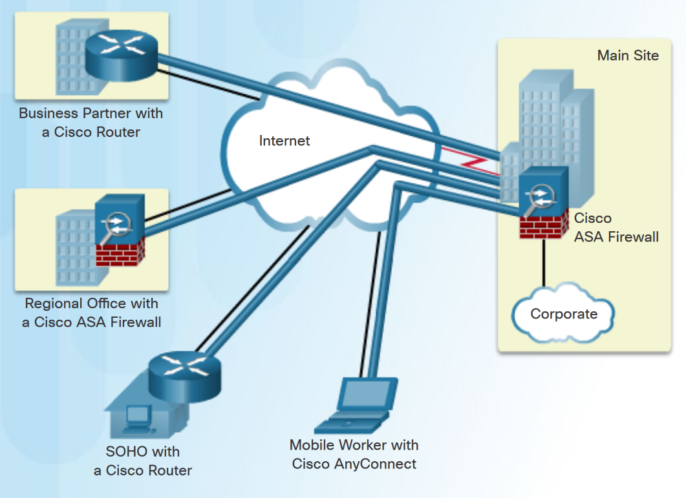
Introducing VPNs
A VPN is a private network created via tunneling over a public network, usually the Internet.
A secure implementation of VPN with encryption, such as IPsec VPNs, is what is “usually” meant by virtual private networking.
The two concepts of tunneling and security should not be confused!
To implement VPNs, a VPN gateway is necessary - could be a router, a firewall, etc.
Notes:
In the simplest sense, a VPN connects two endpoints, such as two remote offices, over a public network to form a logical connection.
The logical connections can be made at either Layer 2 (not covered here) or Layer 3 of the OSI model.
Common examples of Layer 3 VPNs are:
Generic Routing Encapsulation (GRE)
Multiprotocol Label Switching (MPLS)
Internet Protocol Security (IPsec)
Other solutions can rely on SSL: SSL VPN is a technology that provides remote-access connectivity from a web browser and relay on its native SSL encryption.

Slide 3
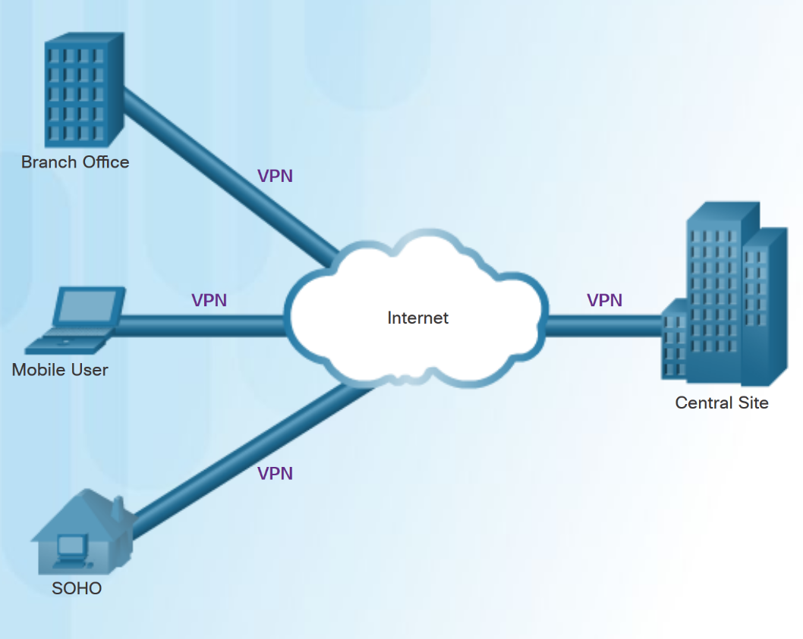
Benefits of VPNs
A Virtual Private Network (VPN) is a private network that is created via tunneling over a public network, usually the Internet.
VPNs have multiple benefits, including:
Compatibility with broadband technology
Cost savings
Security
Scalability
Notes:
The benefits of a VPN include the following:
Cost savings - VPNs enable organizations to use cost-effective, high-bandwidth technologies, such as DSL to connect remote offices and remote users to the main site.
Scalability - Organizations are able to add large amounts of capacity without adding significant infrastructure.
Compatibility with broadband technology - Allow mobile workers and telecommuters to take advantage of high-speed, broadband connectivity.
Security - VPNs can use advanced encryption and authentication protocols.

Slide 4
Types of VPNs
In the simplest sense, a VPN connects two endpoints, such as two remote offices, over a public network to form a logical connection.
The logical connections can be made at either Layer 2 or Layer 3 of the OSI model.
Common examples of Layer 3 VPNs are:
Generic Routing Encapsulation (GRE)
Multiprotocol Label Switching (not covered here - MPLS)
Internet Protocol Security (IPsec)
Notes:
There are two popular site-to-site tunneling protocols:
GRE – for IP as well as non IP traffics; and multi cast traffic
Ipsec – for IP unicast traffic

Slide 5
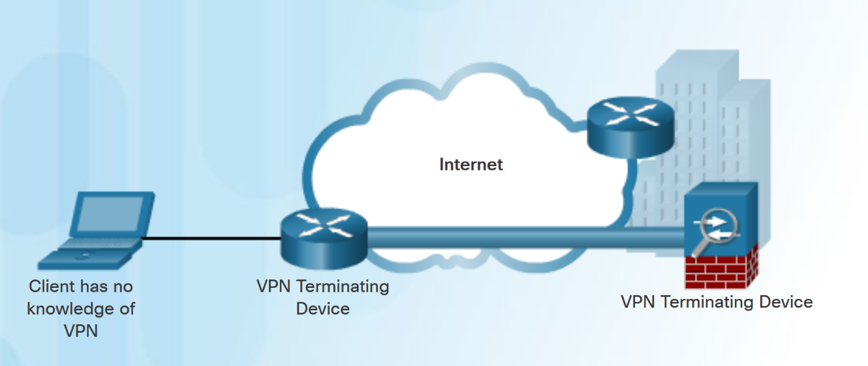
Site-to-Site VPNs
Site-to-site VPNs connect entire networks to each other, for example, connecting a branch office network to a company headquarters network.
In a site-to-site VPN, end hosts send and receive normal TCP/IP traffic through a VPN “gateway”.
The VPN gateway is responsible for encapsulating and encrypting outbound traffic.
Notes:
The VPN remains static and internal hosts have no knowledge that a VPN exists
An extension of a classic WAN network.
Connect remote networks to each other.
A site-to-site VPN can connect a branch office network to a company headquarter network.
Replaces a leased line or Frame Relay connection, because most corporations now have Internet access.

Slide 6
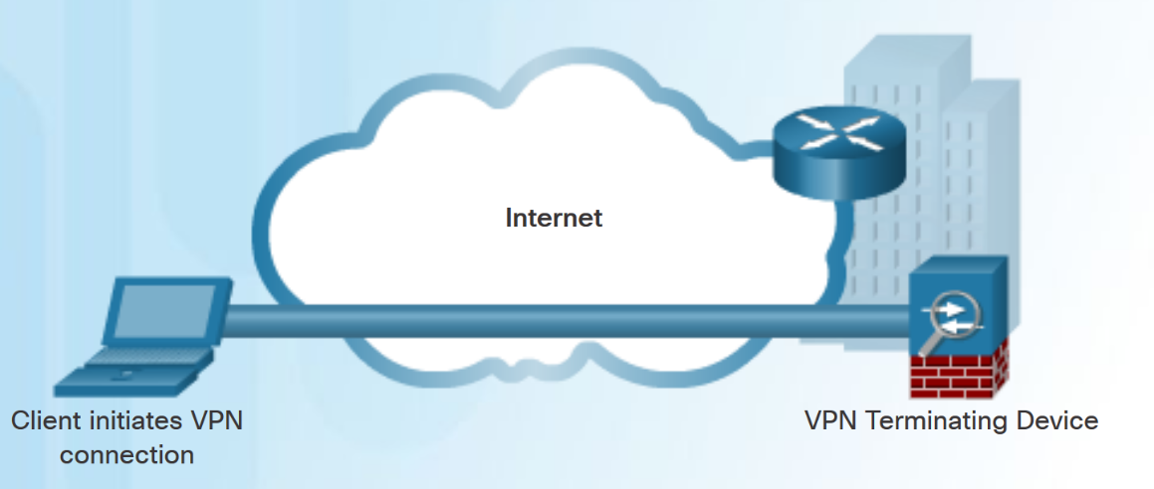
Remote Access VPNs
A remote-access VPN supports the needs of telecommuters, mobile users, and extranet traffic.
Allows for dynamically changing information, and can be enabled and disabled.
Used to connect individual hosts that must access their company network securely over the Internet.
VPN client software may need to be installed on the mobile user’s end device.
Notes:
Support a client/server architecture. A VPN client (remote host) requires secure access to the enterprise network via a VPN server device at the network edge.

Slide 7
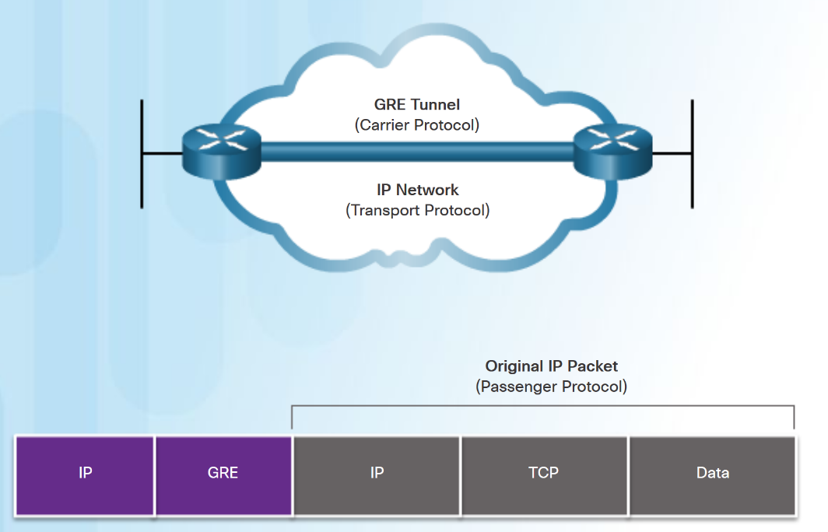
GRE Introduction
Generic Routing Encapsulation (GRE) is a non-secure, site-to-site VPN tunneling protocol.
GRE manages the transportation of multiprotocol and IP multicast traffic between two or more sites
A tunnel interface supports a header for each of the following:
An encapsulated protocol - or passenger protocol, such as IPv4, IPv6.
An encapsulation protocol - or carrier protocol, such as GRE.
A transport delivery protocol, such as IP.

Slide 8
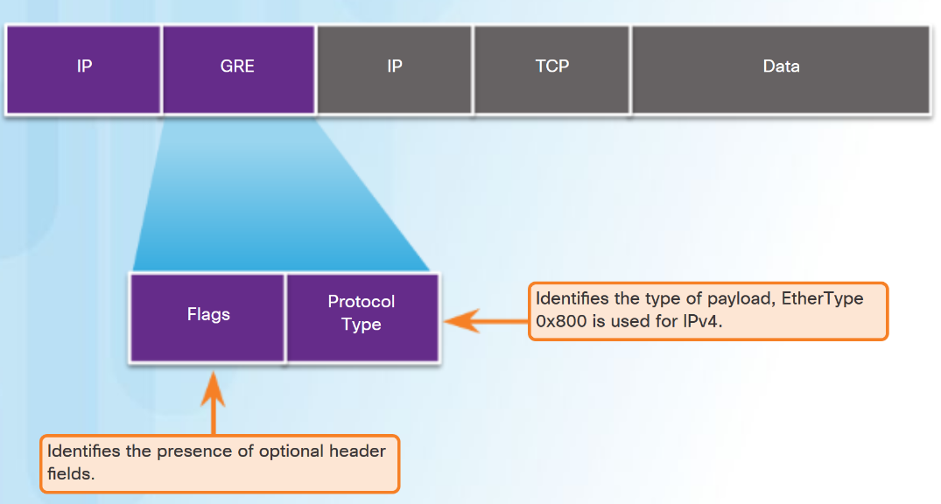
GRE Characteristics
GRE is defined as an IETF standard (RFC 2784).
In the outer IP header, 47 is used in the protocol field.
GRE encapsulation uses a protocol type field in the GRE header to support the encapsulation of any OSI Layer 3 protocol.
GRE is stateless.
GRE does not include any strong security mechanisms.
GRE header, together with the tunneling IP header, creates at least 24 bytes of additional overhead for tunneled packets.
Notes:
The advantage of GRE is that it can be used to tunnel non-IP traffic over an IP network.
Unlike IPsec, which only supports unicast traffic, GRE supports multicast and broadcast traffic over the tunnel link. Therefore, routing protocols are supported in GRE.
GRE does not provide encryption; if needed, IPsec should be configured.

Slide 9
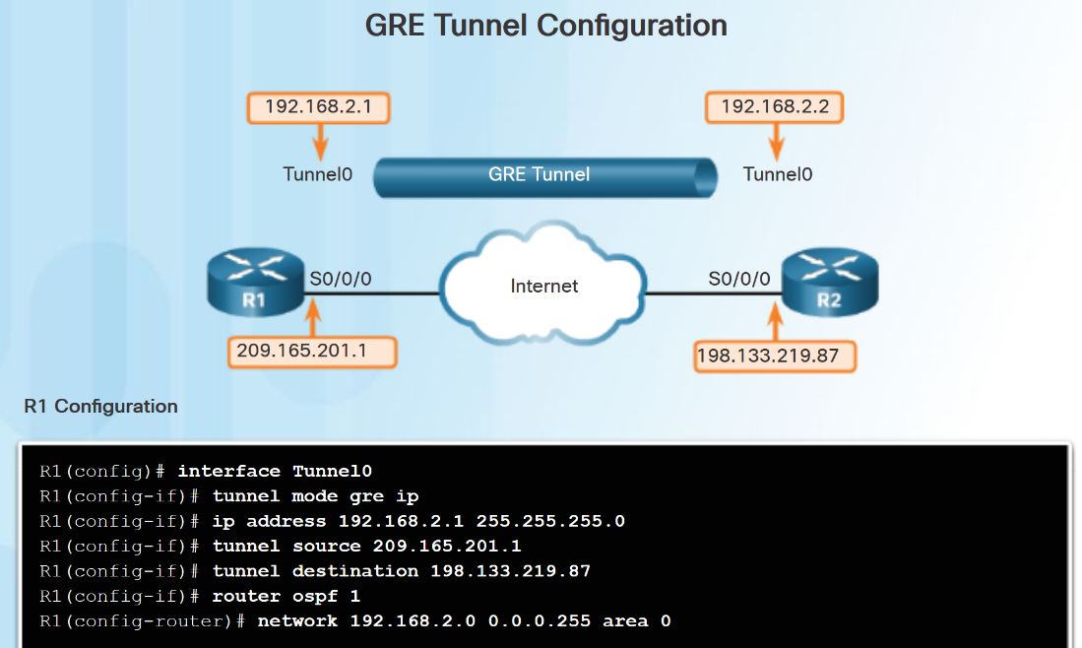
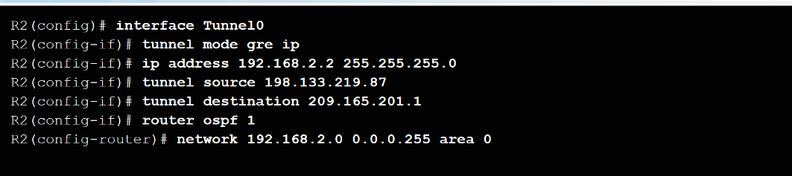
Configure GRE
Five steps to configuring a GRE tunnel:
Step 1. Create a tunnel interface using the interface tunnel number command.
Step 2. Configure an IP address for the tunnel interface. (Usually a private address)
Step3. Specify the tunnel source IP address.
Step 4. Specify the tunnel destination IP address.
Step 5. (Optional) Specify GRE tunnel mode as the tunnel interface mode.
Note: The tunnel source and tunnel destination commands reference the IP addresses of the preconfigured physical interfaces.

Slide 10
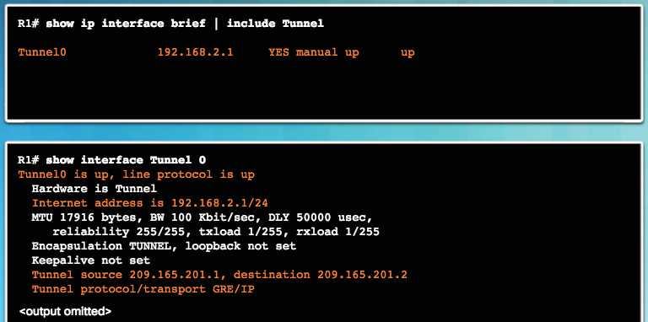
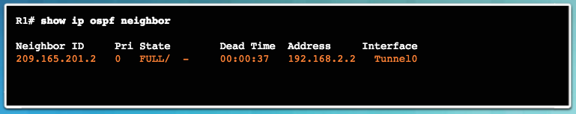
Verify GRE
Use the show ip interface brief command to verify that the tunnel interface is up.
Use the show interface tunnel command to verify the state of the tunnel.
Use the show ip ospf neighbor command to verify that an OSPF adjacency has been established over the tunnel interface.

Slide 11
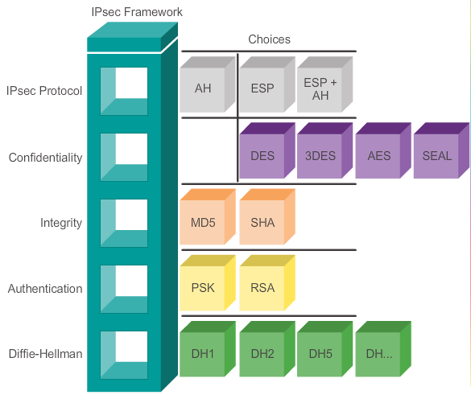
IPsec As an IETF Standard Cont.
GRE tunnel do not provide encryption – but GRE can be implemented on top of IPsec
The IPsec framework (only the framework is revisited below)
The IPsec framework consists of five building blocks.
The administrator selects the algorithms used to implement the security services within that framework.

